Slide 1
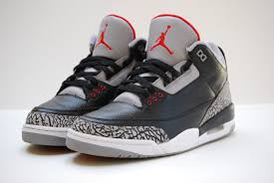
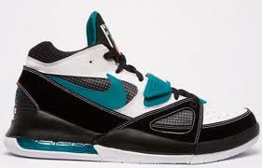
Are Jordan’s Better than Nike’s?
You
will
decide!
VS

Slide 2
Cost of the Shoe: Higher the cost higher the quality!
High price shows popularity/quality!
VS.
Price drop usually means
sales are low!

Slide 3
Quality: Durability how long do they last?
30 months!
Months
Only 12 months!

Slide 4
Sales: Who sells more shoes?
$2.25 Billion!
In billions $
$300 Million
$40 Million
*According to Forbes.com

Slide 5
Student Survey: Out of the student body who prefers what shoe?
Jordan’s: 35 students
Nike’s: 24 students
Other: 11 students
Total Students Surveyed: 70

Slide 6
Let’s See who believes what shoe is best! Let’s take a vote!
On your iPad, go to the following website:
https://kahoot.it
Enter Game Pin on the Screen!

