Slide 1
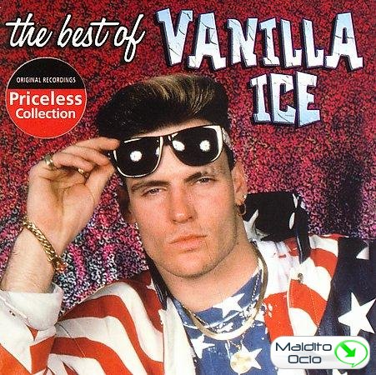
G.B. Muckrakers
“If there was a problem, yo I’ll solve it…”
Vanilla Ice

